Slide 1
Java Workshop 8: Polymorphism
A dog is a dog
Ben Schwarz

Slide 2
Polymorphism
Greek – many forms
There are 3 main types of polymorphism in Java:
Overloading (covered in functions workshop)
Subtype polymorphism
Parametric polymorphism (covered in a later Generic Types workshop
By process of elimination, we’ll be looking at the second, which is usually* referred to simply as polymorphism.
* Usually is used in the context of Australian university courses and discussions with Australian academia. Plus, the other types have nicer names.

Slide 3
We have an animal class.
Dog, cat and turtle extend animal.
Animal
Mammal
Turtle
Dog
Cat

Slide 4


Dogs are Animals
We have an array Kingdom.
I have a dog object, and if it is convenient to think of it as a dog object that is fine
But I can also say it is an animal, but it really is a dog.
A dog is a dog is a dog. But a dog is still an animal. We can make an animal object which is really a dog.

Slide 5

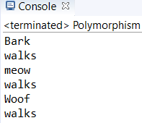

Dogs are Animals
This allows us to add different subtypes of animal to an animal array.
It doesn’t matter what type of animal it is:
When it gets to the dog, it will move like a dog,
When it gets to a cat, it moves like a cat.

Slide 6


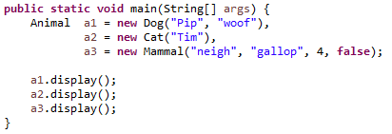
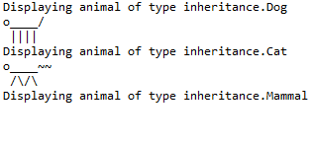
Polymorphism
This type of polymorphism refers to certain properties of inherited types:
They can be treated as an instance of any of their superclasses
Their methods while treated as their superclass still operate as defined in the subclass
These properties hold anywhere – variables, attributes, parameters, return types, etc.

Slide 7

Polymorphism’s Limitations
In the previous examples, the variables were all still treated just as Animal objects. This means:
You can’t get a Dog’s name
You can’t check if a Cat is a pet
You can’t check if a Mammal is a pet
Anything that wasn’t defined in the superclass will throw an error if you try to access it.
Attributes -> e.g. dog.name
Methods -> e.g. cat.scratch() if it were defined

Slide 8
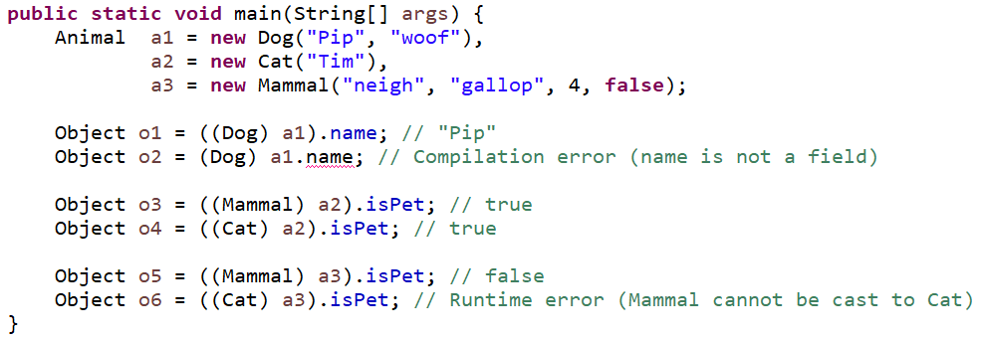



Casting
Casting labels a variable as belonging to a class.
Syntax:
(datatype) varName

Slide 9



The instanceof Keyword
The system still knows what each variable is really an instance of:
We can check it like so:
This can be used to safely cast:
.getClass() vs instanceof
.getClass() gives a class object
instanceof is a keyword that specifically checks that an object is an instance of a class or one of its subclasses
Using instanceof is generally preferred.

Slide 10
Your Turn
Write a function which
Takes in an animal object as a parameter
Prints the most specific class that it is an instance of
If it is a Mammal or subtype, print whether it is a pet
If it is a Dog or Cat, print its name
Write a function which
Iterates over an array of Animal objects
Prints the name of every Dog
Prints the total number of Mammals
Experiment with the casting of primitive types, such as float -> int
Assume that only the base code for J9 is being used, i.e.
Animal
Mammal
Cat
Dog

Slide 11
Summary
You should now be able to:
Assign and pass instances of subclasses as if they were their superclass
Determine whether a given object belongs to a class or one of its subclasses
Use casting to access attributes and methods of subclasses
Truncate floating point numbers to integers

